Slide 1

DEPARTMENT OF COMPUTER SCIENCE & ENGINEERING
SCHOOL OF COMPUTING
1156CS701- MAJOR PROJECT
INTERNSHIP THROUGH ABROAD
WINTER SEMESTER(2023-2024)
REVIEW - II
“Envisioning S.E.M's by Inducting Edge
Computing and Predictive Modelling for
Achieving Net Zero Goals”
SUPERVISED BY
Dr. G.DHANABALAN M.E.,Ph.D.,
Associate Professor.
PRESENTED BY
1. MANIDEEP REDDY SRIPATHI (VTU17713) (20UECS0809)

Slide 2
INDUSTRY DETAILS
Institute Name : National Ilan University
Duration of Internship : 23/09/2023 - 22/01/2024
Duration of Internship in Months : 4 Months
Industry Guide Name : Hwang-Cheng Wang
Industry Guide Mobile No : (03) 9357400
Industry Guide Mail ID : hcwang@niu.edu.tw
Industry Address : No. 1, Section 1, Shennong Rd, Yilan City, Yilan County, Taiwan 260
Project Completion Status as of now - In Progress

Slide 3
AGENDA
ABSTRACT
OBJECTIVE
INTRODUCTION
LITERATURE REVIEW (SOFT COPY OF PAPERS TO BE LINKED AS HYPERLINK)
DESIGN AND METHODOLOGIES
IMPLEMENTATION
TESTING
INPUT AND OUTPUT
INCLUDE DEMO VIDEO-1 (Till REVEW-1)
INCLUDE DEMO VIDEO-2(Complete Implementation of Project)
CONCLUSION
WEB REFERENCES LINK(TILL REVIEW DATE ALL LINKS TO BE INCLUDED DAY WISE)
INCLUDE YOUR 2 PHOTOS OF YOUR INDUSTRY WORKING ENVIRONMENT
PLAGIARISM REPORT OF PPT
REFERENCES

Slide 4
ABSTRACT
With the abrupt realization of the requirement for sustainability and sustainable processes, there is an acute increase in awareness of how resource generation and consumption are being conducted. In the modern world, new ideas and solutions are heavily dependent on computation, power, and energy. Electrical energy is one of the fundamental and foundational aspects upon which all these innovations are realized. The rising apprehension of applying sustainable practices to action has called for solutions to improve and achieve a set of ‘net zero goals’. In response to the growing demand for electricity in the 21st century, a strategic approach is essential for effective energy conservation. This research outlines an implementation of a smart energy meter, built from the ground up, inducted into an edge network, and uses predictive modeling to complete a set of a tripartite eco-system. The design of an individual edge is designed and depicted, along with its performance as a part of an edge node in a multi-nodal network. This initiative aims to utilize modern predictive approaches to map consumption and take precautionary and insightful actions that curb excessive utilization and waste of electricity. The project envisions a future where IoT’s real-time monitoring and edge intelligence’s rapid data processing contribute to achieving net zero goals.

Slide 5
OBJECTIVES
Aim of the Project:
The aim of the project is to implement a smart energy meter within an edge network, leveraging predictive modeling to achieve a tripartite eco-system. The goal is to enable real-time monitoring of electricity consumption, coupled with rapid data processing and insightful actions to mitigate excessive utilization and waste. Ultimately, the project aims to contribute to the realization of 'net zero goals' by integrating modern technologies like IoT and edge intelligence into energy management practices.

Slide 6
INTRODUCTION
In response to the escalating demand for sustainability and eco-conscious practices, heightened awareness of the intricacies surrounding resource generation and consumption has emerged. The aftermath of the COVID-19 pandemic has spurred numerous innovations, discoveries, and developmental breakthroughs, heavily reliant on computation, power, and energy. Electrical energy stands as a fundamental cornerstone amid these pillars, crucial for groundbreaking advancements. The quest for implementing sustainable practices into action has driven a compelling search for solutions to enhance and actualize 'net zero goals'. This concern encompasses multifaceted factors, with energy generation and consumption at its core. From 2010 to 2019, the average energy production trend exhibited a positive growth rate of 2.5% annually, with global power generation in 2022 increasing by approximately 2.3%. However, despite this growth, only 20.4% of energy is prone to electrification, while the majority still relies on fossil fuels. As of 2021, there are reportedly about 2.3 billion residences worldwide, a number expected to exponentially grow by 2024, underscoring the significant impact potential of proposed energy solutions.

Slide 7
This project introduces a smart energy meter meticulously engineered from the ground up and integrated into an edge network. This innovation employs predictive modeling within a tripartite ecosystem, focusing on the design and performance of individual edges as part of a multi-nodal network. By leveraging modern predictive approaches, we aim to map consumption patterns and proactively curb excessive utilization and waste of electricity. This initiative envisions a future where real-time monitoring through the Internet of Things (IoT) and rapid data processing via edge intelligence collectively contribute to achieving net zero goals. Our work not only addresses current challenges but also envisions a sustainable energy landscape for future generations. In the ever-evolving energy systems landscape, a thorough exploration of technical intricacies surrounding sustainable energy solutions is imperative. Through this interdisciplinary exploration, we aim to provide valuable insights that inform policy decisions, drive societal acceptance, and propel technological advancements, ultimately fostering a future where sustainability is not just a goal but a collective reality.

Slide 8
LITERATURE REVIEW
In the field of IoT-based smart energy meters and energy management, various studies have made noticeable contributions. Thummar et al. [1] developed an IoT-based metering system that usessensors, Arduino, and Wi-Fi to monitor and communicate energy data, enhancing user engagement with real-time consumption insights.
Karpagam [2] proposed a smart energy meter using Arduino and ESP8266 to detect power theft, emphasizing energy conservation and modern IoT applications in energy management.
Midul [3] designed an IoT smart energy meter with GSM and WiFi capabilities, focusing on theft detection and prepaid billing, thus contributing to efficient energy usage in households.
Pengwah et al. [4] introduced a novel method for estimating non-technical losses in power networks, using smart meter data to detect electricity theft, showcasing the potential of data-driven solutions in power distribution.
Testasecca et al. [5] discussed the optimization of smart energy networks, emphasizing data-driven techniques for efficient and sustainable energy management, including machine learning algorithms and scientific models.

Slide 9
Ashokkumar et al. [5] presented a system to provide real-time energy data to users, aiming at efficient energy usage and conservation, enhancing sustainable energy management in residential settings. In the realm of smart grid security and efficient energy management, various studies have offered innovative solutions.
Selvarathi et al. [6] developed Eliot, a smart prepaid energy meter providing real-time electricity usage data, aiming to reduce consumption and enhance transparency.
Badr et al. [7] proposed a privacy-preserving energy prediction scheme usin federated learning for smart grids, addressing communication efficiency and data privacy.
Kumar et al. [8] investigated the resilience of smart electric meters against cyber security attacks, highlighting the need for robust cybersecurity in the energy sector. In IoT-based energy management, several studies have focused on enhancing efficiency and security.
Harini et al. [9] developed a system for automated energy monitoring, billing, and control, emphasizing IoT’s role in residential energy management.

Slide 10
Jamuna et al. [10] described an IoT-based metering system with a microcontroller and GSM modem, addressing manual electrical maintenance and theft detection.
Manikandan et al. [11] introduced a system for automated power usage calculation, billing, and payment, using IoT to improve efficiency in energy management. Innovative approaches in smart grid security and energy monitoring have been explored in recent studies.
Maule et al. [12] focused on an IoT-based electricity monitoring system integrating Web of Things for effective energy management.
Zhu et al. [13] explored deep active learning for electricity theft detection, utilizing CNN and Bayesian active query to reduce data labeling costs. Lastly,
Diaz et al. [14] presented Vampire, a smart energy meter for synchronous monitoring in computer systems, integrating various IoT technologies for accurate energy consumption recording

Slide 11
DESIGN AND METHODOLOGIES
MODULE 1: Node Device Establishment
MODULE 2: Intelligent Edge Network Supported by Node Data
MODULE 3: User Interface for Edge Control

Slide 12
MODULE:1 Node Device Establishment
The Node Device is the cornerstone of the proposed smart energy meter system. Though it is simple in the sense of a single unit, when it is joined with many such nodes, it groups into a very big and complex network that provides an exceptional outcome. It encompasses the following key components:
Microcontroller :
A microcontroller forms the brain of the Node Device. It orchestrates the interaction between sensors, data processing, and communication with the Edge Network. Parametric values, namely, voltage and current data from sensors, are efficiently gathered using an ESP32 microcontroller. This data, crucial for understanding electricity consumption, is transmitted to a Raspberry Pi in the edge network. ESP32 is particularly applied in this case as the master of the circuit. The ESP32's real-time capabilities enhance responsiveness. A Raspberry Pi model 4B is used as a slave for computing and preparing the payload response based on the data provided by the Master ESP32.

Slide 13
Voltage Sensor : The inclusion of a voltage sensor is essential for accurately measuring the voltage in the electrical system. This sensor, often based on Hall Effect technology, provides real-time voltage data to the microcontroller. The high precision ensures reliable energy consumption calculations .
Current Sensor :
A current sensor is integrated to measure the flow of electrical current in the system. It is proven that an accurate sense of current can be obtained by employing Hall Effect sensor or Electromagnetic Induction principles . While there are many alternatives to detect current, using the above-said method, the current sensor delivers precise current readings to the microcontroller. This data is crucial for comprehensive energy usage analysis.

Slide 14
LCD Sensor :
To enhance user interaction and provide real-time feedback, an LCD sensor is incorporated. This sensor serves as the display interface, showing users their current energy consumption, historical data, and other relevant information. It facilitates user awareness and engagement in energy conservation. Additionally, the LCD provides a handy validation to the electrician or any other electrical operator to verify its performance and operation.

Slide 15
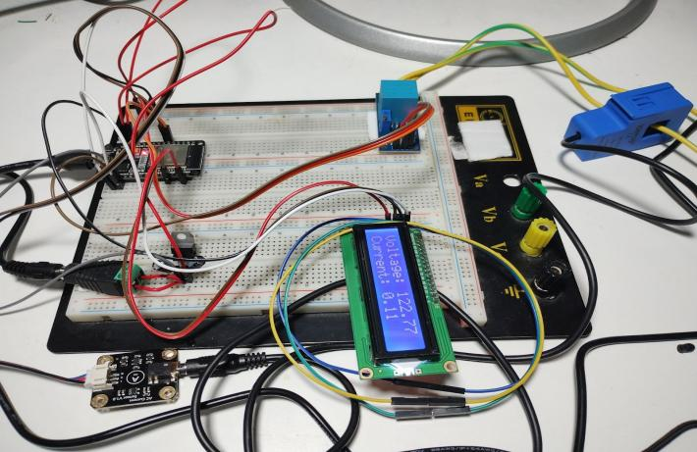
Circuit Design

Slide 16
MODULE:2 Intelligent Edge Network Supported by Node Data
The main purpose of this research is to utilize the implementation of an edge network to reduce data overload while maximizing the relevance of monitoring data . This would allow the user to organize and utilize energy in a way that promotes net zero goals.
Raspberry Pi 4 Model B Controller:
The above collected data is transmitted to a Raspberry Pi, serving as the slave component of the node device edge of the network. On the Raspberry Pi, a SARIMA model processes the received data, predicting energy consumption costs for the next month.

Slide 17
Predictive Modelling : Once the data is successfully stored in the local database within the Raspberry Pi 4 model B, a live script takes in the data or updates the data to produce or change the prediction accordingly. This makes the standard node of a network intelligent. Thus, the name Intelligent Edge Node. The intelligence algorithm includes the employment of a customized ML model. The proposed predictive modeling approach includes an ensemble machine learning model designed for the sophisticated task of predicting electricity consumption on a specific future billing day. At its core, the model integrates advanced time series forecasting and ensemble learning techniques to provide accurate and reliable predictions

Slide 18
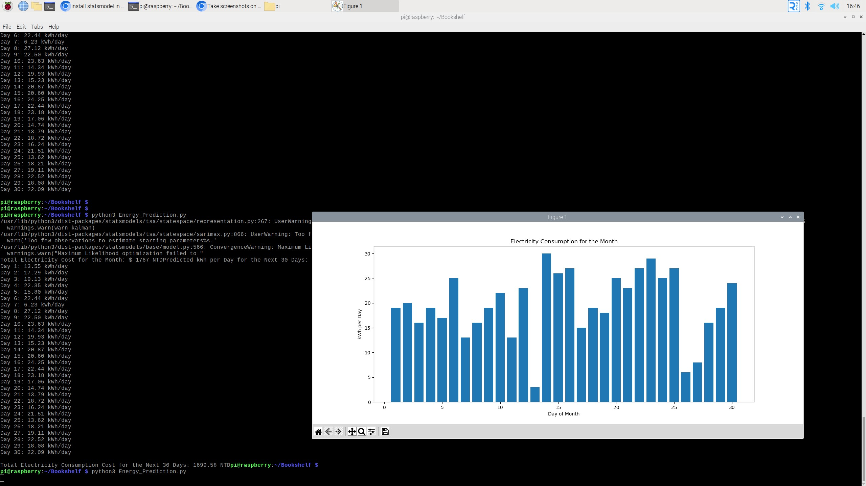
Sarima Model Prediction Details :

Slide 19
MODULE:3 User Interface for Edge Control
To complement the intelligent edge network, a user-friendly mobile app is developed, offering real-time energy consumption monitoring. Integrated with the ESP32 and Raspberry Pi infrastructure, the app provides users with immediate insights into their current energy usage patterns, fostering awareness and informed decision-making. Leveraging AI capabilities, the app delivers personalized tips for energy conservation derived from the SARIMA model's analysis of historical data. Additionally, the app forecasts next month's energy consumption , empowering users with anticipated costs to plan and adjust their usage patterns and With a user-centric design, the app ensures seamless navigation through real-time data, conservation tips, and future predictions, enhancing the overall user experience. This methodology combines hardware integration, advanced analytics, and a user-friendly mobile interface to create a comprehensive energy consumption management system.
The app emphasizes data security with user authentication, encryption, and access controls. It boosts user engagement with energy-saving challenges and notifications. Available on multiple platforms, the app is regularly updated to incorporate user feedback and new technologies, ensuring its effectiveness and adaptability in energy management.

Slide 20
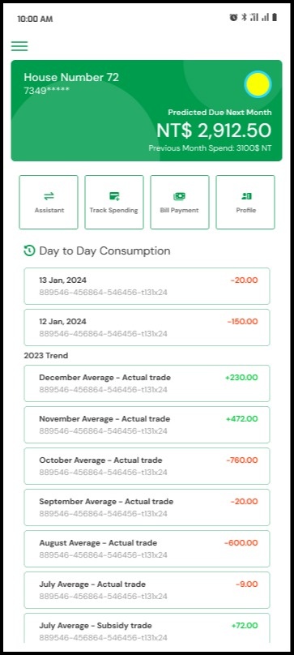
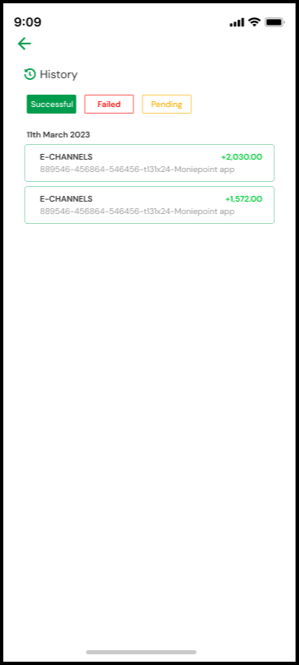
Android Application User Interface

Slide 21
IMPLEMENTATION
ARCHITECTURE DIAGRAM
DATA FLOW DIAGRAM
ER DIAGRAM

Slide 22
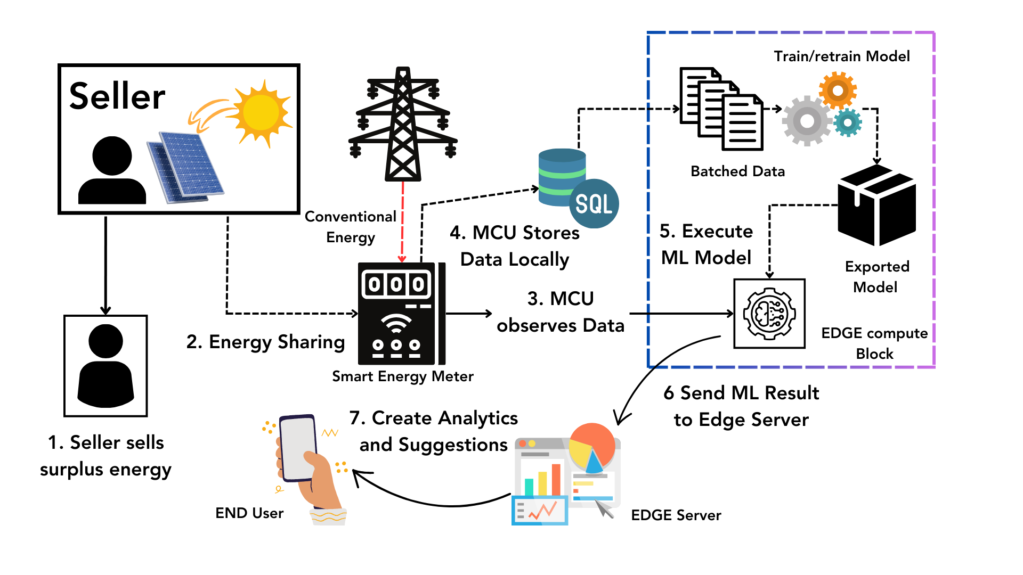
ARCHITECTURE DIAGRAM

Slide 23
DATA FLOW DIAGRAM
Data From Current sensor
Running Predictive Model
Send data to mobile
Data From Voltage sensor
Processing Data In Raspberry Pi
Final Prediction Result In Mobile
Send Data to ESP32
Send Data to Raspberry Pi

Slide 24
ER- DIAGRAM
User_Details
Profile
Name
Admin_Id
Name
Id
M
Mobile User
Access
1
Android Administrator
1
Electricity bill No
Predicted Data
Updates
1
Admin_Id
Database Administrator
Delete_users
Update_details
Add_users

Slide 25
TESTING
UNIT TESTING
INTEGRATION TESTING
FUNCTIONAL TESTING

Slide 26
UNIT TESTING
Testing for the smart energy meter project involves rigorous unit testing to ensure the accuracy and reliability of individual components. This includes verifying sensor readings, data processing algorithms, and predictive modeling accuracy. Communication between the energy meter and edge network undergoes testing for reliability and error handling, while edge intelligence is scrutinized to validate its decision-making logic. Integration testing assesses the cohesive operation of components, while boundary condition and error handling tests ensure robustness and resilience. Performance testing measures system responsiveness and resource utilization, and security testing validates data encryption and access control mechanisms.
Through meticulous testing, the project aims to achieve real-time monitoring of electricity consumption and contribute to 'net zero goals'. By integrating IoT and edge intelligence, the system can effectively mitigate waste and promote sustainable energy management practices.

Slide 27
INTEGRATION TESTING
Integration testing for the smart energy meter project is essential to validate the seamless operation of its interconnected components. This phase brings together individual modules to assess their collective functionality within the system. Integration tests ensure that data flows smoothly between components, communication protocols are correctly implemented, and interfaces are properly integrated.
Moreover, integration testing evaluates the interaction between the energy meter and edge network components, validating their interoperability and synchronization. It ensures that data processing algorithms receive accurate inputs from sensors, predictive models utilize updated data for analysis, and edge intelligence makes informed decisions based on real-time information. By conducting thorough integration testing, the project can ensure the holistic functionality of the smart energy meter system, facilitating reliable monitoring and mitigation of electricity consumption towards the realization of 'net zero goals'.

Slide 28
FUNCTIONAL TESTING
Functional testing for the smart energy meter project focuses on validating its features and functionalities to ensure they meet the specified requirements. This testing phase involves assessing the system's ability to perform essential tasks such as real-time monitoring of electricity consumption, data processing, and predictive modeling. Functional tests verify that the energy meter accurately collects data from sensors, processes it efficiently, and generates insights to facilitate informed decision-making.
Additionally, functional testing evaluates the responsiveness and usability of the system's interface, ensuring that users can interact seamlessly with the smart energy meter. It encompasses scenarios such as simulating various energy consumption patterns, testing the system's ability to detect anomalies, and verifying the effectiveness of mitigation actions. By conducting comprehensive functional testing, the project can guarantee the reliability and effectiveness of the smart energy meter in contributing to sustainable energy management practices and achieving 'net zero goals'.

Slide 29
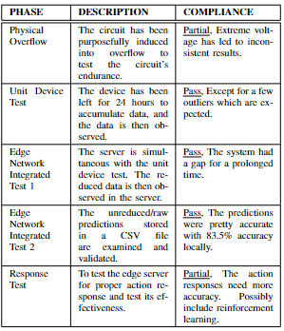
DIFFERENT TESTINGS

Slide 30
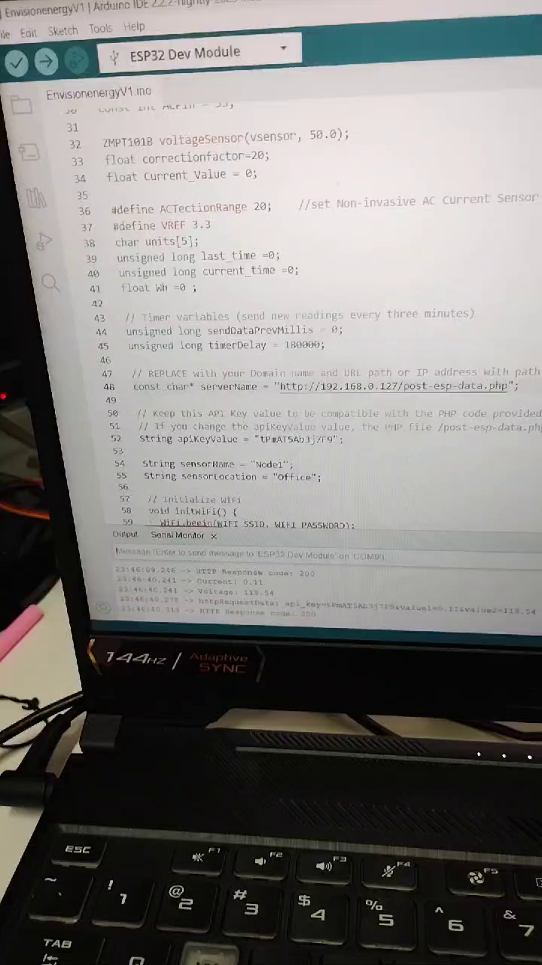
INPUT AND OUTPUT

Slide 31
CONCLUSION
This research, which integrated an intelligent edge network with an ensemble machine learning model in smart energy meters, has successfully met its set requirements, focusing on achieving net zero goals. The efficient data management facilitated by the Node Device, utilizing ESP32 microcontroller and multiple sensors, laid a robust foundation for accurate energy consumption analysis. The advanced predictive analytics, combining SARIMA, Random Forest, and GBM algorithms within the Raspberry Pi 4 Model B, performed above par with 83.5\% accuracy in forecasting electricity consumption, enabling informed and sustainable energy usage decisions. The user-friendly mobile app enhanced user engagement and awareness, fostering sustainable energy behaviors. Additionally, the edge server has been able to give accurate action recommendations based on the set resource pool. The system's rigorous testing and validation further affirmed its reliability, safety, and effectiveness, underscoring its potential for broader application in smart energy management. Thus, the study provides an adequate foundation for the implementation of edge technology in energy conservation and net zero goals.

Slide 32
Web references/video links
Enerdata, “World electricity production statistics,” Enerdata Yearbook, 2023. [Online]. Available https://yearbook.enerdata.net/electricity/world-electricity-production-statistics.html.
“Electricity domestic consumption data,” 2023, [Online].Available:https://yearbook.enerdata.net/electricity/electricity-domesticconsumption-data.html.
Share of electricity in total final energy consumption,” Enerdata Yearbook, 2023. [Online]. Available: https://yearbook.enerdata.net/electricity/share-electricity-final-consumption.html

Slide 33

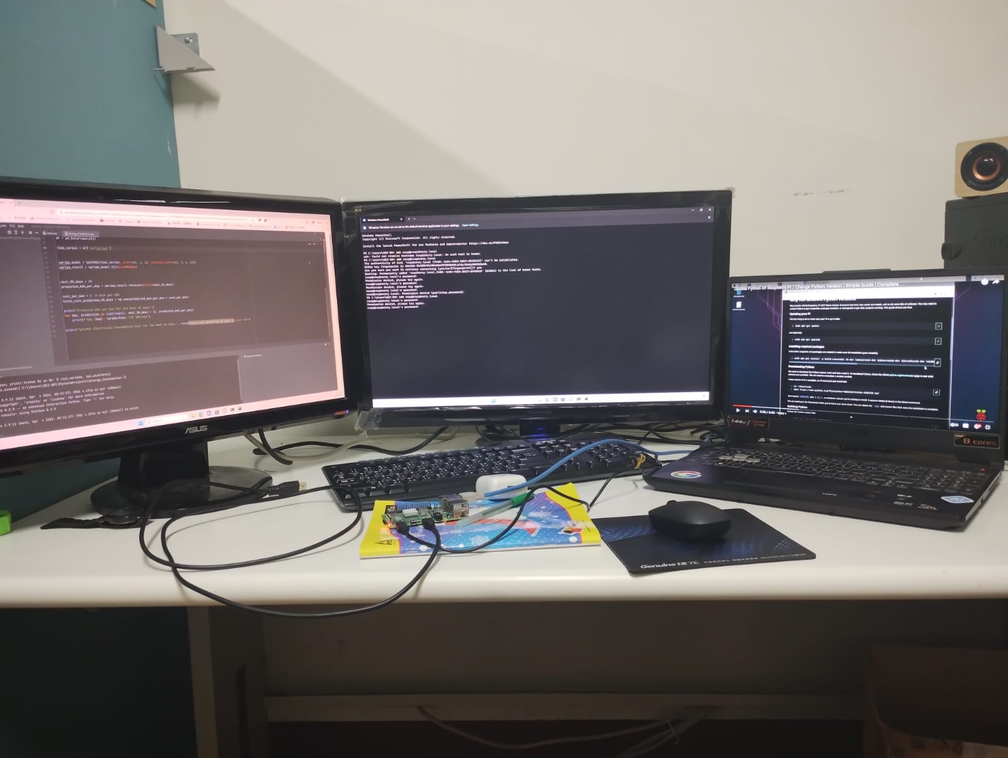
INCLUDE YOUR 2 PHOTOS OF YOUR INDUSTRY WORKING ENVIRONMENT

Slide 34
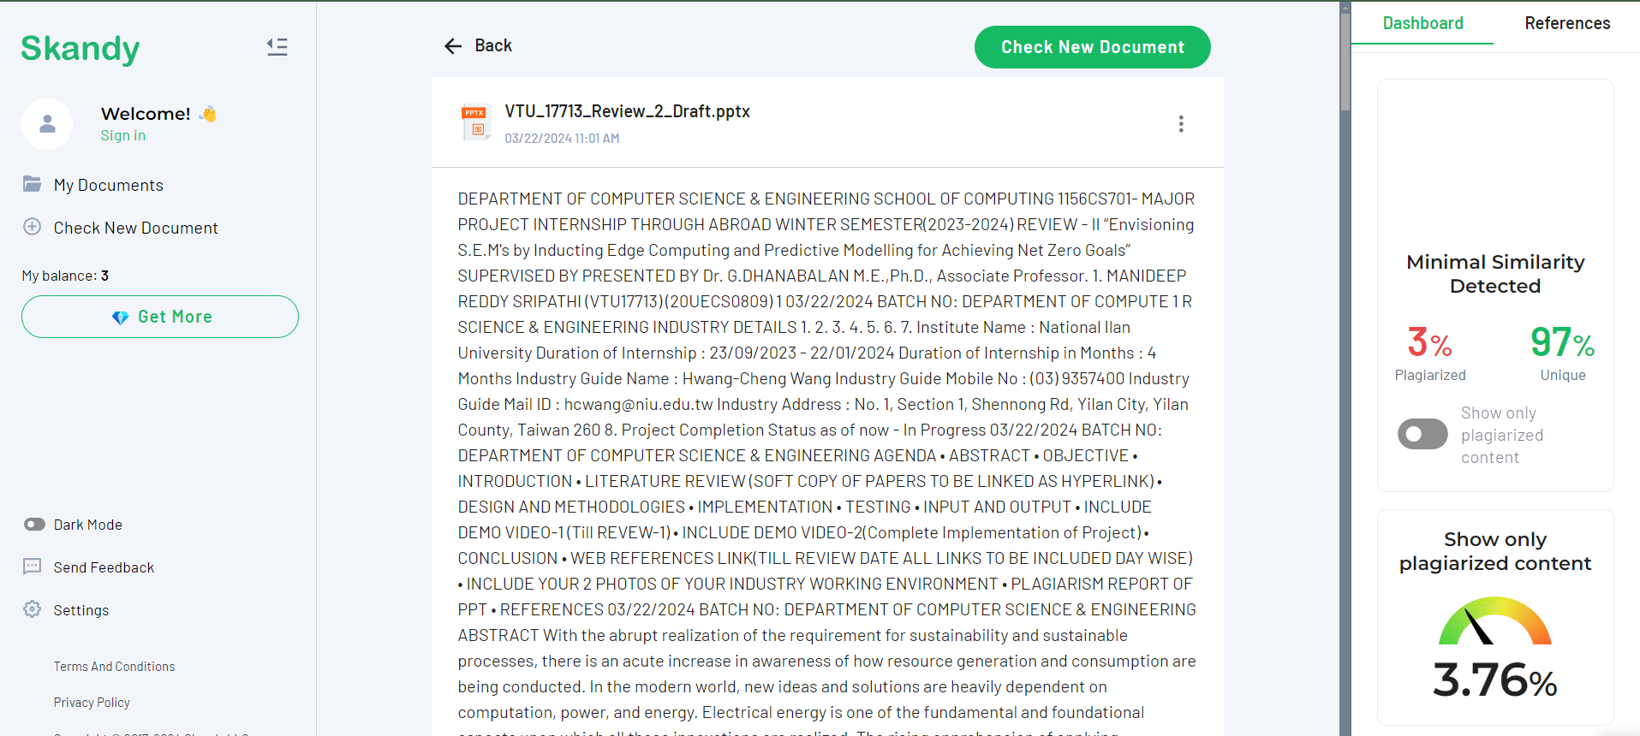
Plagiarism Report of PPT

Slide 35
REFERENCES
[1] H. B. Thummar, J. M. Jangid, and A. Patel, “E-billing system using smart energy meter for domestic application,” pp. 695–701, 2023.
[2] M. Karpagam, S. S. S, S. S, and S. S, “Smart energy meter and monitoring system using internet of things (iot),” pp. 75–80, 2023.
[3] M. A. H. S. Midul, S. H. Pranta, A. S. I. Biddut, S. I. Siam, M. R. Hazari, and M. A. Mannan, “Design and implementation of iot-based smart energy meter to augment residential energy consumption,” in 2023 3rd International Conference on Robotics, Electrical and Signal Processing Techniques (ICREST), Dhaka, Bangladesh, 2023, pp. 106–110.
[4] A. B. Pengwah, R. Razzaghi, and L. L. H. Andrew, “Model-less non- technical loss detection using smart meter data,” IEEE Transactions on Power Delivery, vol. 38, no. 5, pp. 3469–3479, 2023.
[5] T. Testasecca, M. Lazzaro, E. Sarmas, and S. Stamatopoulos, “Recent advances on data-driven services for smart energy systems optimization and pro-active management,” in 2023 IEEE International Workshop on Metrology for Living Environment (MetroLivEnv), Milano, Italy, 2023, pp. 146–151.

Slide 36
[6] N. Ashokkumar, V. Arun, S. Prabhu, V. Kalaimagal, D. Srinivasan,and B. Shanthi, “Design and implementation of iot based energy efficient smart metering system for domestic applications,” in 2023 9th International Conference on Advanced Computing and Communication Systems (ICACCS), Coimbatore, India, 2023, pp. 1208–1212.
[7] C. Selvarathi, S. M. Monishsurya, P. N. Kumar, and K. Deepakraj, “An improved internet of things (iot) based smart prepaid energy meter,” in 2023 Second International Conference on Electronics and Renewable Systems (ICEARS), Tuticorin, India, 2023, pp. 374–379.
[8] M. Mahmoud, A. M. Mohamed, and Y. Fang, “Privacy-preserving and communication-efficient energy prediction scheme based on federated learning for smart grids,” vol. 10, no. 9, 2023, pp. 7719–7736.
[9] H. Kumar, O. A. Alvarez, and S. Kumar, “Experimental evaluation of smart electric meters’ resilience under cyber security attacks,” IEEE Access, vol. 11, pp. 55 349–55 360, 2023.

Slide 37
[10] K. Harini and V. Anbarasu, “An iot framework based automated wireless meter system for monitoring, billing and controlling power consumption,” in 2023 International Conference on Computer Communication and Informatics (ICCCI), Coimbatore, India, 2023, pp. 1–6.
[11] P. Manikandan, G. Ramesh, S. N. K, U. Kartheek, R. V. S. Prem, and Y. S. S. Reddy, “A smart electronics energy measurement, monitoring, billing and payment system using iot,” in 2023 2nd International Conference on Applied Artificial Intelligence and Computing (ICAAIC), Salem, India, 2023, pp. 1378–1381.
[12] L. C. T. Maule, K. R. Thilak, B. G. Devi, P. Anbarasu, A. N. V. S. S. Balaji, and N. Franklin, “An overview of experimental load tracking, billing and energy consumption monitoring device using iot,” in 2023 2nd International Conference on Applied Artificial Intelligence and Computing (ICAAIC), Salem, India, 2023, pp. 1347–1351.
[13] L. Zhu, W. Wen, J. Li, C. Zhang, B. Zhou, and Z. Shuai, “Deep active learning-enabled cost-effective electricity theft detection in smart grids,” IEEE Transactions on Industrial Informatics, vol. 20, no. 1, pp. 256–268, 2024.

Slide 38
[14] A. D ́ıaz, B. Prieto, J. Escobar, and T. Lampert, “Vampire: A smart energy meter for synchronous monitoring in a distributed computer system,” Journal of Parallel and Distributed Computing, vol. 184, p. 104794, 2024

Slide 39
THANK YOU

